Slide 1
CPU Scheduling
First Come First Serve
Shortest Job First

Slide 2
Names and Student IDs of Team Members

Slide 3
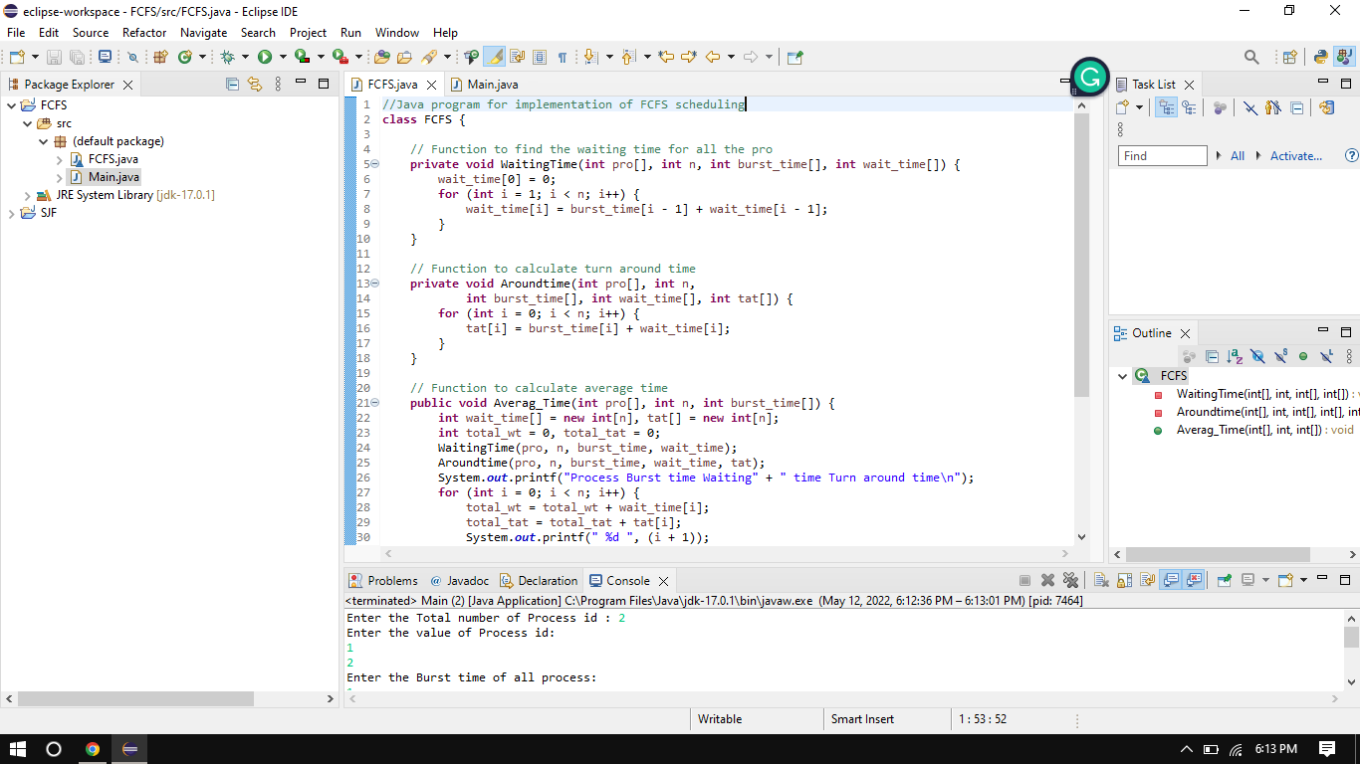
First Come First Serve

Slide 4
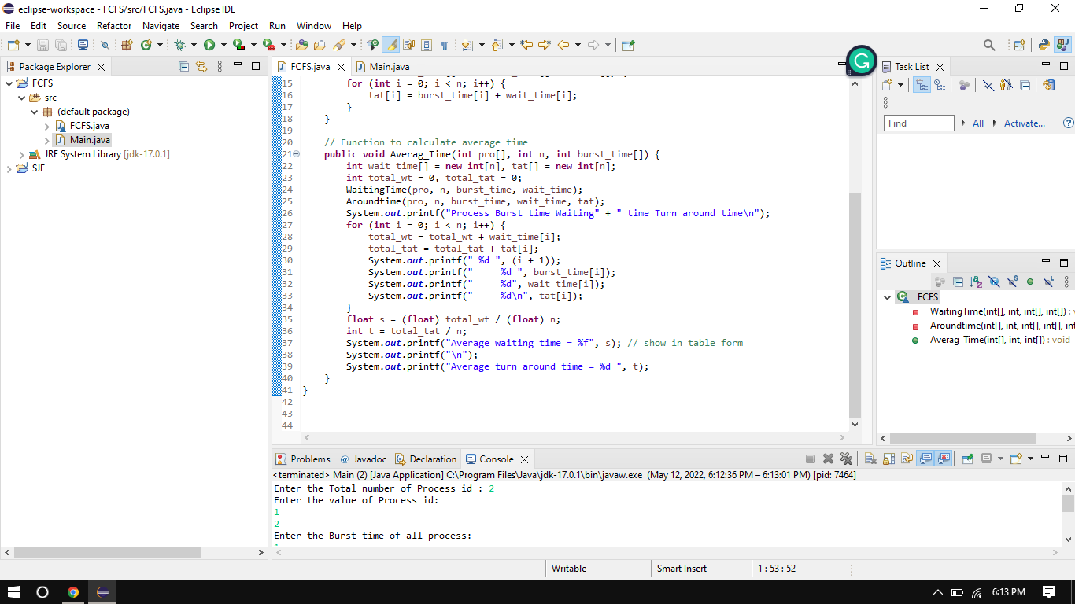
First Come First Serve

Slide 5
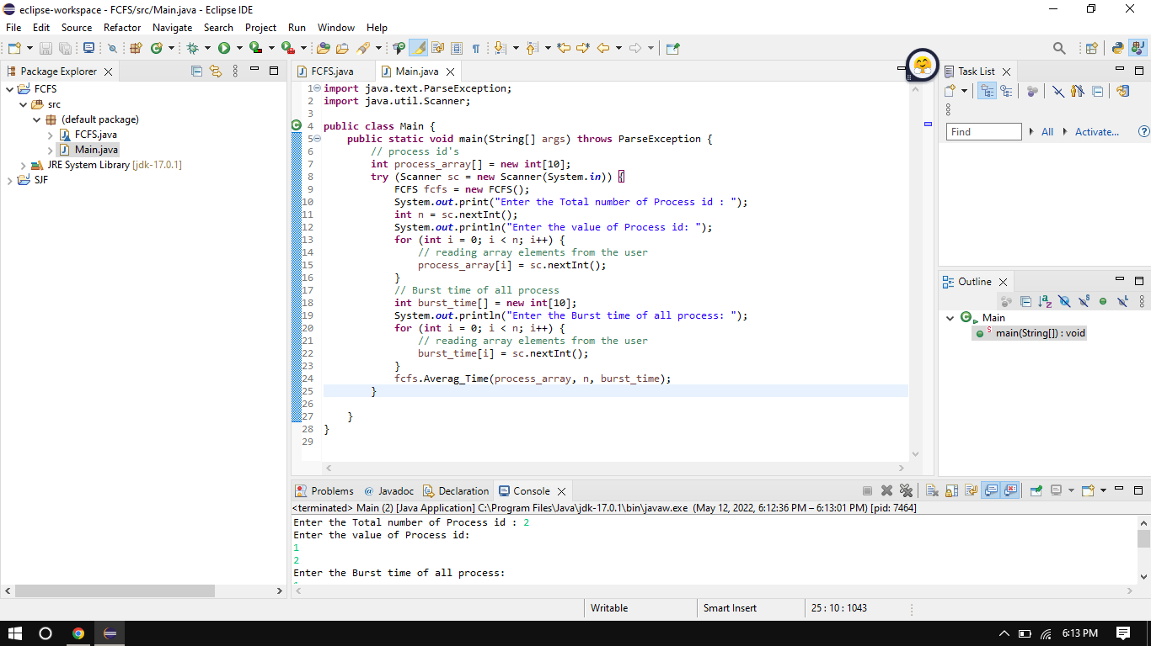
First Come First Serve

Slide 6
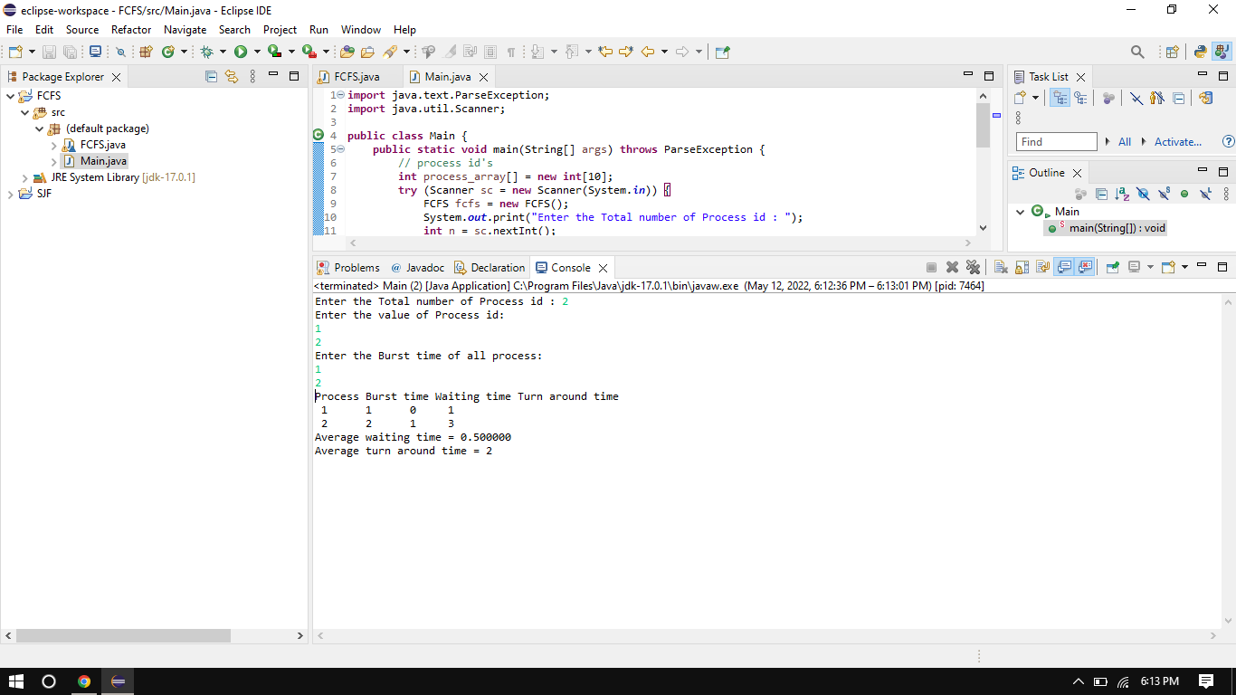
First Come First Serve

Slide 7
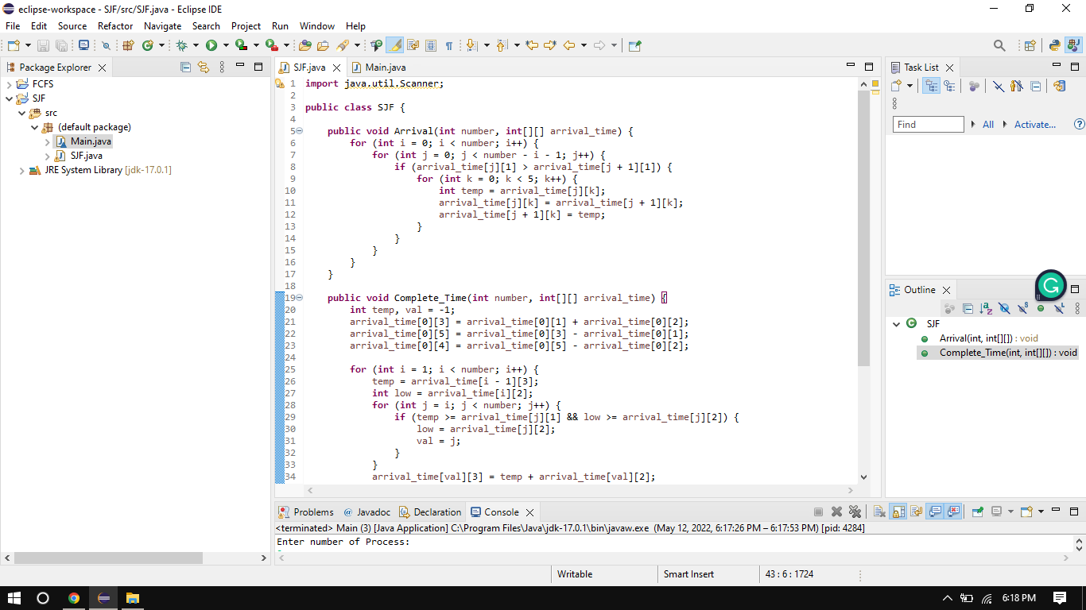
Shortest Job First

Slide 8
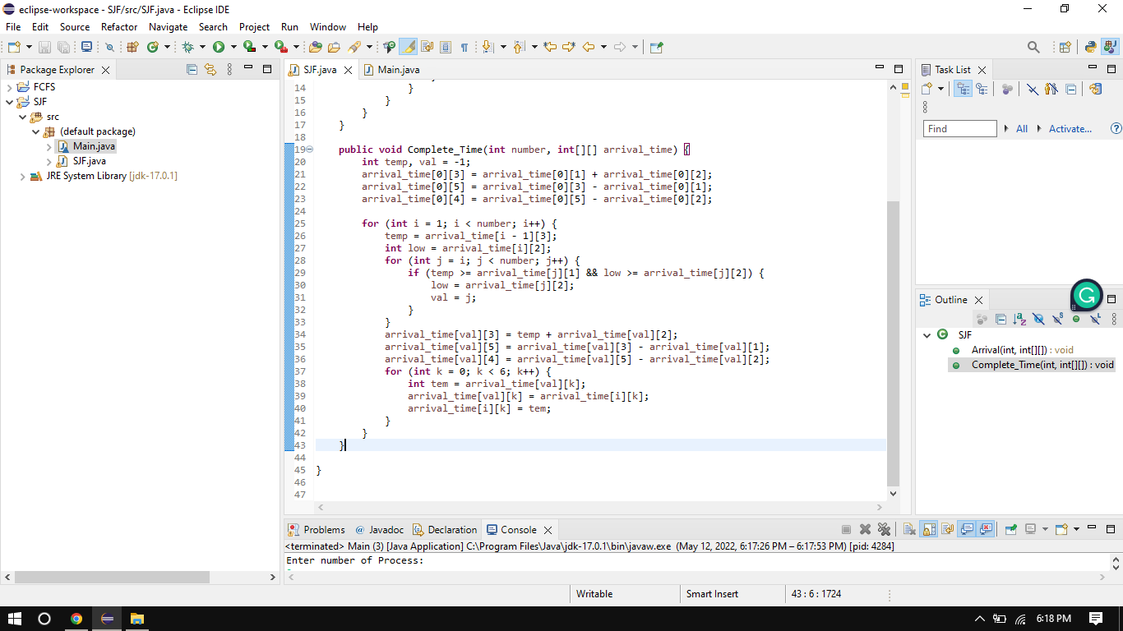
Shortest Job First

Slide 9
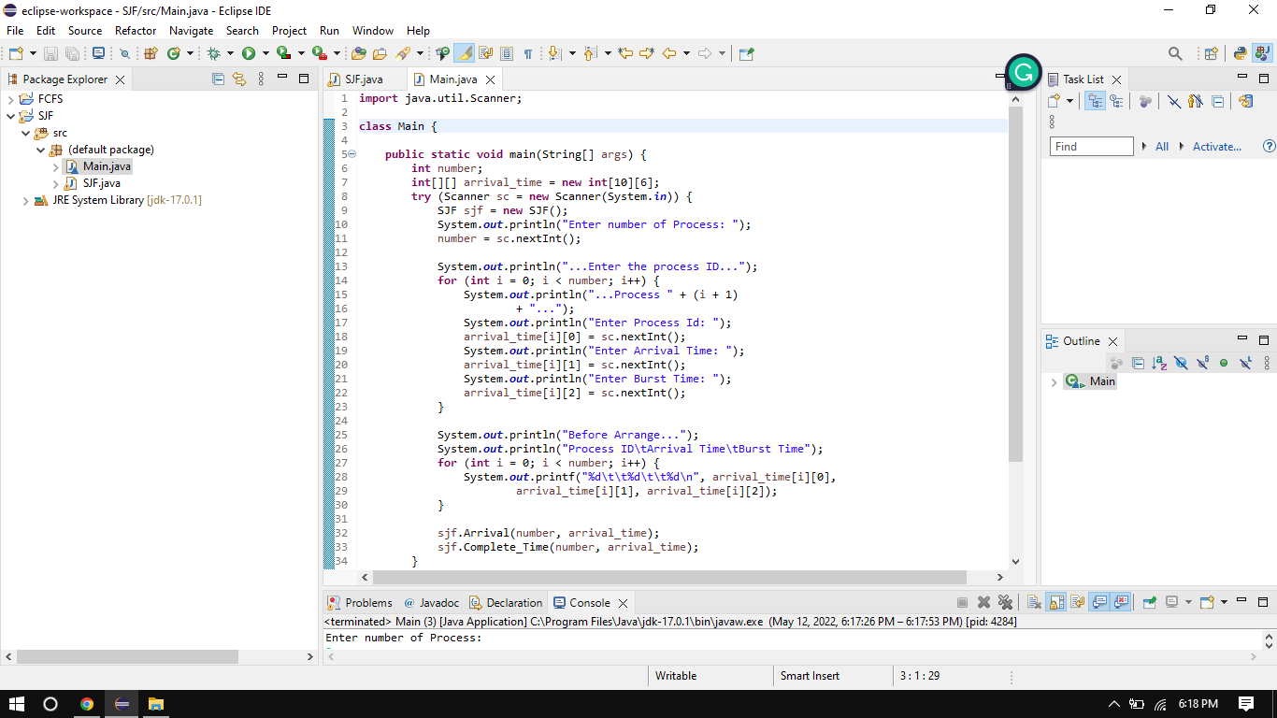
Shortest Job First

Slide 10
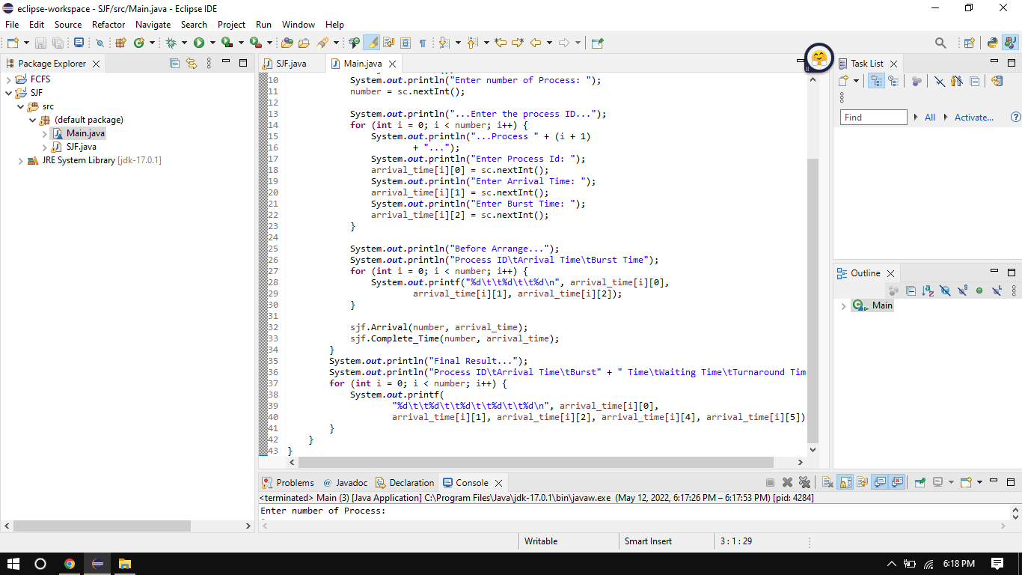
Shortest Job First

Slide 11
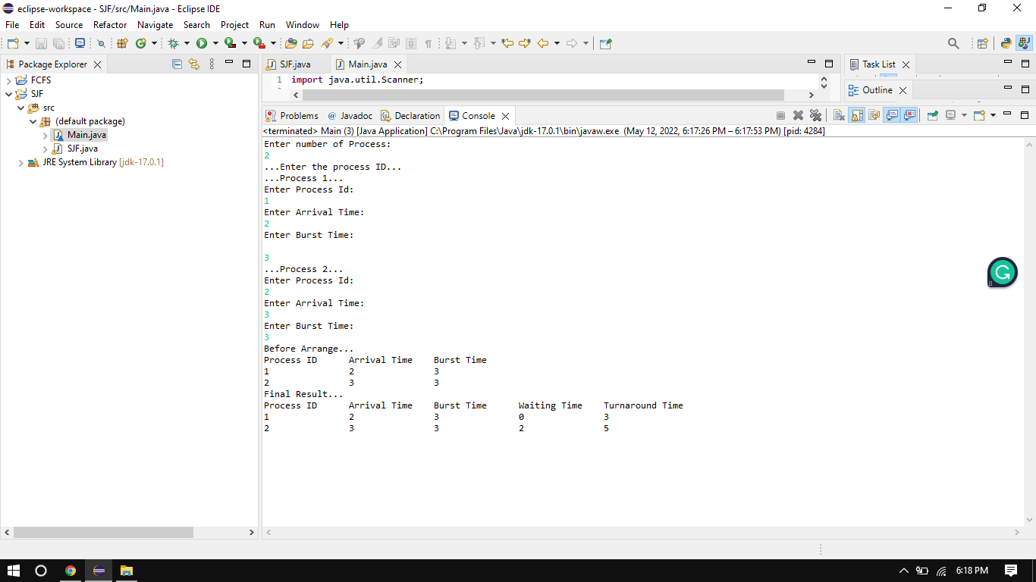
Shortest Job First

Slide 12
. Features and capabilities of your project
The main purpose of any CPU (FCFS & SJF)scheduling algorithm is to keep the CPU as busy as possible.
A measure of the work done by the CPU is the number of processes executed and completed per unit of time.

Slide 13
. Features and capabilities of your project
Response Time: ...
Turnaround time: ...
Waiting time: ...
Fairness:

Slide 14
A simple user manual instructing a new user on how to use your program
First of all I tell you first come first Serve algorithm Program
In the first step you need to Input the total processes id number then also you need along with their burst time.
Then my program will find waiting time (wt.) for all processes.
As the first process that comes need not to wait so
waiting time for process 1 will be 0 i.e. wt.[0] = 0.

Slide 15
A simple user manual instructing a new user on how to use your program
Then my program Find waiting time for all other processes i.e. for process I -> wt.[I] = bt[i-1] + wt[i-1]
Then Find turnaround time = waiting_time + burst_time for all processes.
Find average waiting time = total_waiting_time / no_of_processes.
Similarly, find average turnaround time = total_turn_around_time /no_of_processes.
After thet show all value on screen as output on above screen shoot

Slide 16
A simple user manual instructing a new user on how to use your program
Now I tell you first come first Serve algorithm Program
First of all you need to input the total process number
Then you need to input id, brist time, and arrival time against each process.
After input program will calculate Completion Time: The time at which the process completes its execution.
Turn Around Time: Time Difference between completion time and arrival time. Turn Around Time = Completion Time – Arrival Time
Waiting Time(W.T): Time Difference between turn around time and burst time.
Waiting Time = Turn Around Time – Burst Time

Slide 17
A simple user manual instructing a new user on how to use your program
After calculation program will be shown Burst Time, waiting Time, Arrival Time, and Turnaround against each process in proper output in table form as you can see in the above slide.

Slide 18
A breakup of tasks across team members
…………
…………
…………
///////// write here you can know this part///////////

